Slide 1
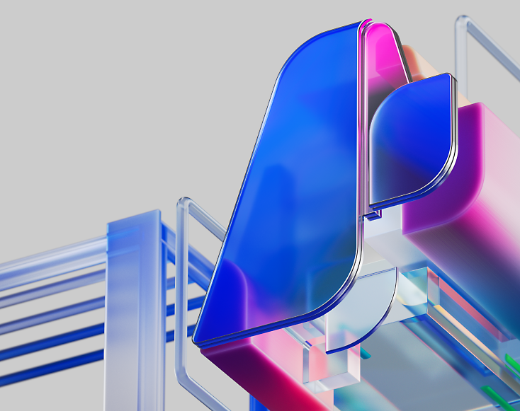
MCP
(Model Context Protocol)
(with a pinch of Azure AI :D )

Slide 2

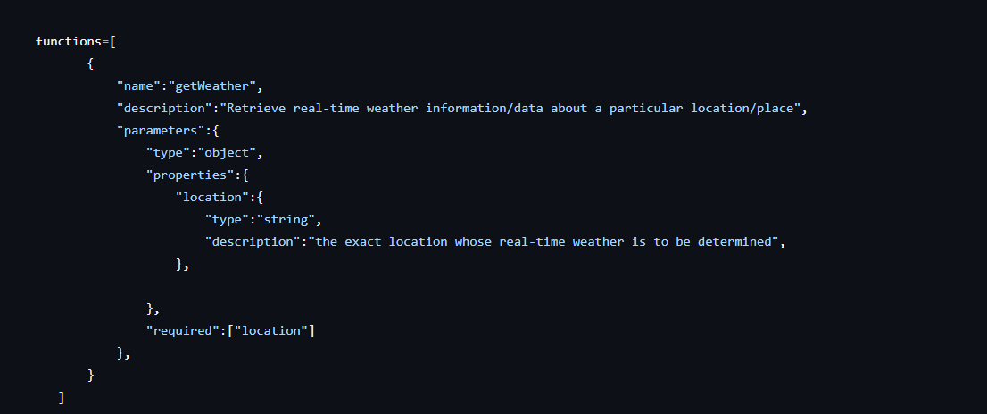
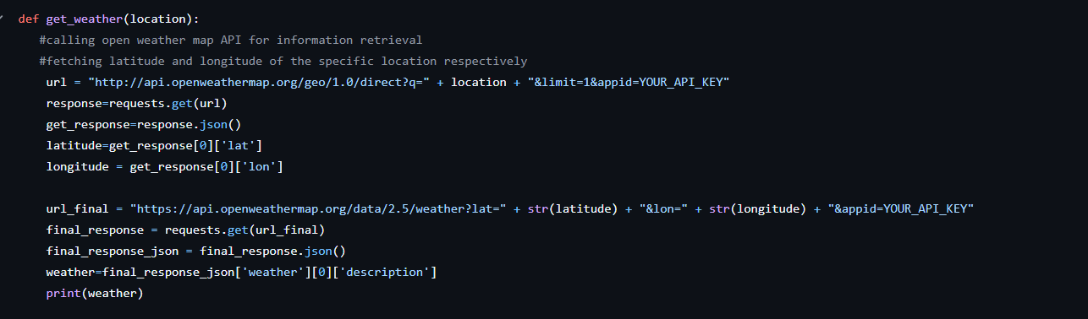
Kuljot is building an Agent that could perform real-time searches – one of them being – “Fetching weather data from a real-time API”

Slide 3

And suddenly all hell breaks loose……
Kuljot learns that overnight the API methods changed – query params, payload structure etc. This essentially means his AI Agent is now good for nothing! THIS IS NOT GOOD ☹
The Solution is – MCP

Slide 4
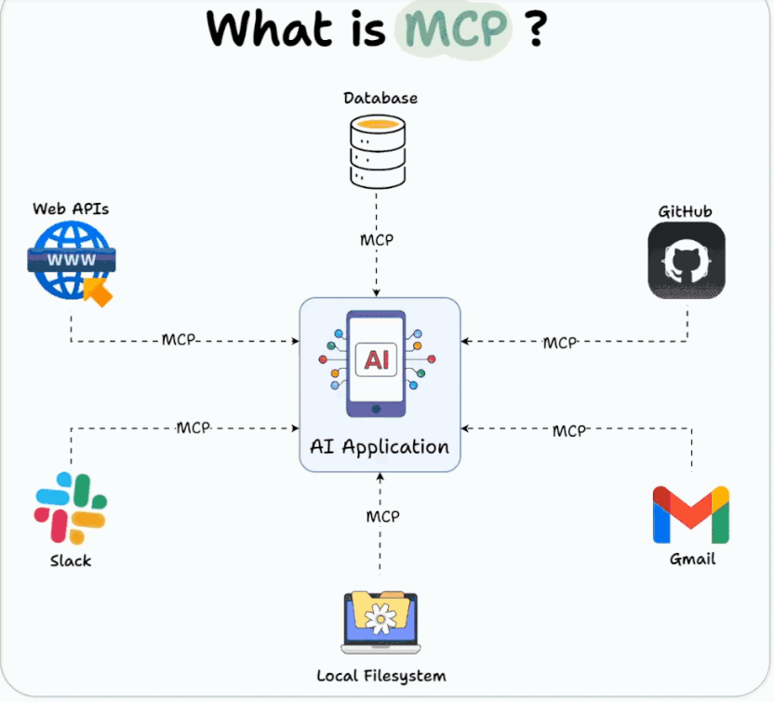
MCP has the potential to function as a universal interface, think of it as the virtual / software version of USB-C for AI. Enabling seamless, secure and scalable data exchange between LLMs/AI Agents and external resources.
MCP uses a client-server architecture where MCP hosts (AI applications) communicate with MCP servers (data/tool providers). Developers can use MCP to build reusable, modular connectors, with pre-built servers available for popular platforms, creating a community-driven ecosystem.

Slide 5
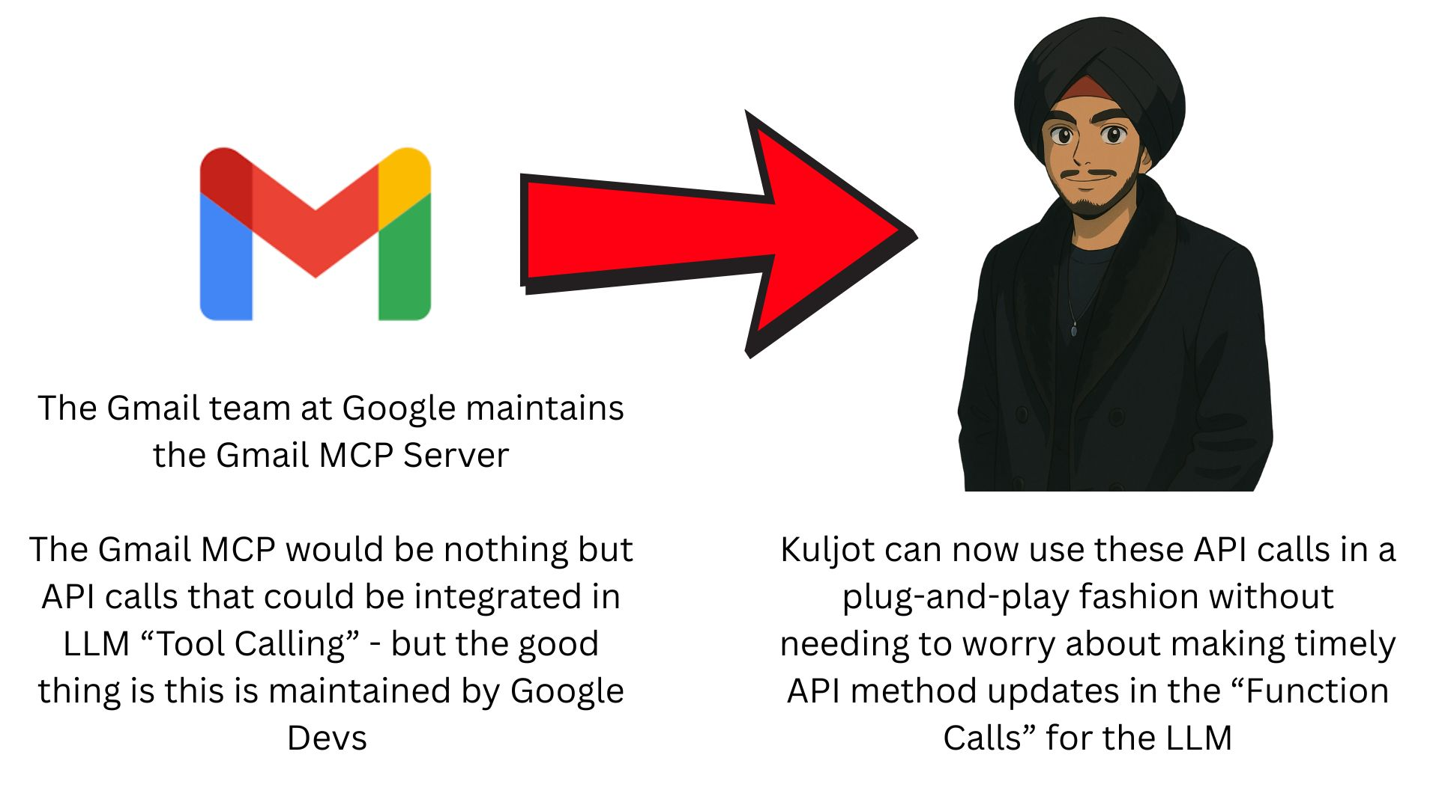
Let's try to break things in a simpler fashion!
These MCP servers will be maintained by a group of people (there’s also a large open-source community driving this forward with MCP servers already built for GitHub, Gmail, Azure etc.)
These MCP servers can be exposed over the internet (users can connect remotely) or even be run as Docker Images locally for data privacy concerns (GitHub MCP Server is a Docker Image)
Remote MCP servers - MCP clients connect to MCP servers over the internet, establishing a connection using HTTP and server-sent events (SSE), and authorizing the MCP client access to resources on the user's account using OAuth.
Local MCP servers MCP clients connect to MCP servers on the same machine, using standard input/output as a local transport method.

Slide 6
But all that Glitters is not Gold……
MCP Servers are quite difficult to implement. These are , what I feel, not that developer friendly and are quite a pain to implement right now with all the toolsets.
This would mean more work for these “Gmail” or “GitHub” MCP devs but less work for us than before ☺
The thought behind this is very optimistic but it still has quite a long way to go.
And by the way, you have Kuljot as your instructor to guide you through and if that’s the case then what’s the worry ☺

